Slide 1
CYCLONES IN AUSTRALIA
October
2021
Wind Direction Prediction

Slide 2
OVERVIEW
An analysis of Australia cyclone since 1990
Machine learning to predict wind direction
Data Set from Bureau of Methodology, contains data from 1907, for the project focus is on the last 30 years
http://www.bom.gov.au/cyclone/tropical-cyclone-knowledge-centre/databases/
Top 10 cyclones

Slide 3
Objective/Questions
What was the top ten cyclones ranked by Central Pressure since 1990?
What were the significant matrix for cyclones over their duration?
Are there correlation between maximum wind speed?
Can we predict the wind direction of cyclones with machine learning?

Slide 4







ETL PROCESS
Clean and modify data using Pandas and Jupyter Notebook
Use Python as the programming language, Flask as the web server and Heroku to host the application
Use HTML, CSS and Javascript on the front end.
Use D3, Plotly, and Leaflet to visualize the data
Developed Python’s Scikit machine learning models

Slide 5
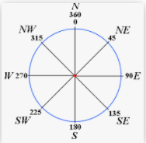
MACHINE LEARNING
Which feature to choose as the “Y” variable?
Suggested to choose the “Max Wind Direction” measured from 0⁰ to 360⁰
I had to group these into 8 compass points covering a range of degrees

Slide 6
Live Demo
https://australiacyclonespredict.herokuapp.com/

Slide 7
MACHINE LEARNING
There were 79 features in the raw data set
Removed all features will ‘null’ and ‘0’ values
This reduced the data set significantly to 6 features for ml model
SURFACE _CODE – Indicates the type of surface (land /water)
LAT/LON of cyclone center
CENTRAL_PRES – Central pressure of the cyclone (hPa)
MAX_WIND_SPD – Estimated maximum mean wind around the cyclone (m/s)
Added 2 derived features called:
CENTRAL INDEX – (0.186*V₆₀) ^{0.746} (Where V₆₀ (one-minute sustained winds) derived from CP)
WAVE HEIGHT – V₆₀ * 0.235

Slide 8
MACHINE LEARNING
Experimented with 3 Models
Support Vector Machine
K Nearest Neighbor
Random Forest
Used all eight features in models
The data set had 1678 observations to train and test

Slide 9
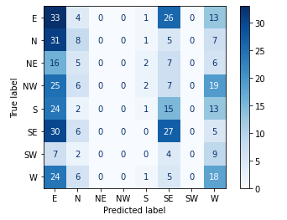
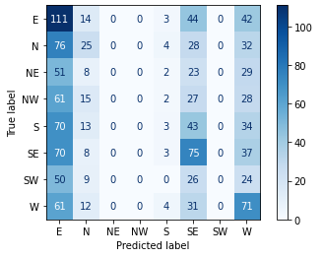
MACHINE LEARNING - SVM
Scaled data using Standard Scaler
Test score accuracy – 20%
Training score accuracy – 22%
Test Classification Training Classification
Test Classification Training Classification

Slide 10
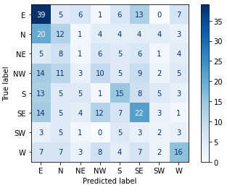
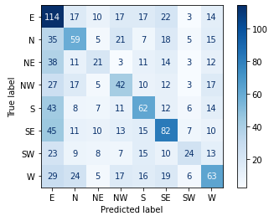
MACHINE LEARNING - KNN
Scaled data using Standard Scaler
Test score accuracy – 27%
Training Classification – 36%
Test Classification Training Classification

Slide 11
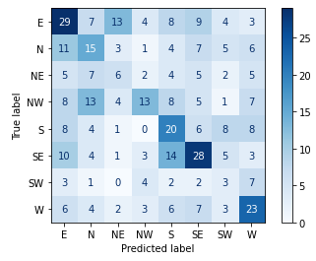
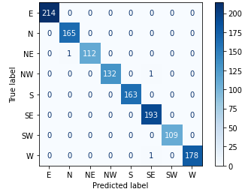
MACHINE LEARNING - RF
Scaled data using Standard Scaler
Feature importance was calculated
Test score accuracy – 32%
Training Classification – 99%
Test Classification Training Classification

Slide 12
MACHINE LEARNING - Analysis
Ranked in terms of classification accuracy:
Random Forest (RF)
K Nearest Neighbor (KNN)
Support Vector Machine (SVM)
No classifier is working well!
Lack of relevant features for classification
For wind direction prediction you need 3D data whereas the current data set is 1D

Slide 13
THANK YOU!
Litesh Samji
Phone
0405 019 268
Email
litesh@y7mail.com

